Slide 1
Chapter 3
Determining Feasibility and Managing Analysis and Design Activities
Systems Analysis and Design
Kendall and Kendall
Fifth Edition

Slide 2
Major Topics
Project initiation
Determining project feasibility
Project scheduling
Managing project activities
Manage systems analysis team members
Kendall & Kendall
Copyright © 2002 by Prentice Hall, Inc.
3-<number>

Slide 3
Project Initiation
Projects are initiated for two broad reasons:
  Problems that lend themselves to systems solutions
  Opportunities for improvement through
    Upgrading systems
    Altering systems
    Installing new systems
Kendall & Kendall
Copyright © 2002 by Prentice Hall, Inc.
3-<number>

Slide 4
Organizational Problems
Identify problems by
Check output against performance criteria
  Too many errors
  Work completed slowly
  Work done incorrectly
  Work done incompletely
  Work not done at all
Kendall & Kendall
Copyright © 2002 by Prentice Hall, Inc.
3-<number>

Slide 5
Organizational Problems
Observe behavior of employees
  High absenteeism
  High job dissatisfaction
  High job turnover
Kendall & Kendall
Copyright © 2002 by Prentice Hall, Inc.
3-<number>

Slide 6
Organizational Problems
Listen to feedback from vendors, customers, and suppliers
  Complaints
  Suggestions for improvement
  Loss of sales
  Lower sales
Kendall & Kendall
Copyright © 2002 by Prentice Hall, Inc.
3-<number>

Slide 7
Project Selection
Five specific criteria for project selection
  Backed by management
  Timed appropriately for commitment of resources
  It moves the business toward attainment of its goals
  Practicable
  Important enough to be considered over other projects
Kendall & Kendall
Copyright © 2002 by Prentice Hall, Inc.
3-<number>

Slide 8
Feasibility
A feasibility study assesses the operational, technical, and economic merits of the proposed project
There are three types of feasibility:
  Technical feasibility
  Economic feasibility
  Operational feasibility
Kendall & Kendall
Copyright © 2002 by Prentice Hall, Inc.
3-<number>

Slide 9
Technical Feasibility
Technical feasibility assesses whether the current technical resources are sufficient for the new system
If they are not available, can they be upgraded to provide the level of technology necessary for the new system
Kendall & Kendall
Copyright © 2002 by Prentice Hall, Inc.
3-<number>

Slide 10
Economic Feasibility
Economic feasibility determines whether the time and money are available to develop the system
Includes the purchase of
  New equipment
  Hardware
  Software
Kendall & Kendall
Copyright © 2002 by Prentice Hall, Inc.
3-<number>

Slide 11
Operational Feasibility
Operational feasibility determines if the human resources are available to operate the system once it has been installed
Users that do not want a new system may prevent it from becoming operationally feasible
Kendall & Kendall
Copyright © 2002 by Prentice Hall, Inc.
3-<number>

Slide 12
Activity Planning
Activity planning includes
  Selecting a systems analysis team
  Estimating time required to complete each task
  Scheduling the project
Two tools for project planning and control are Gantt charts and PERT diagrams
Kendall & Kendall
Copyright © 2002 by Prentice Hall, Inc.
3-<number>

Slide 13
Estimating Time
Project is broken down into phases
Further broken down into tasks or activities
Finally broken down into steps or even smaller units
Estimate time for each task or activity
May use a most likely, pessimistic, and optimistic estimates for time
Kendall & Kendall
Copyright © 2002 by Prentice Hall, Inc.
3-<number>

Slide 14
Gantt Charts
Easy to construct and use
Shows activities over a period of time
Kendall & Kendall
Copyright © 2002 by Prentice Hall, Inc.
3-<number>

Slide 15
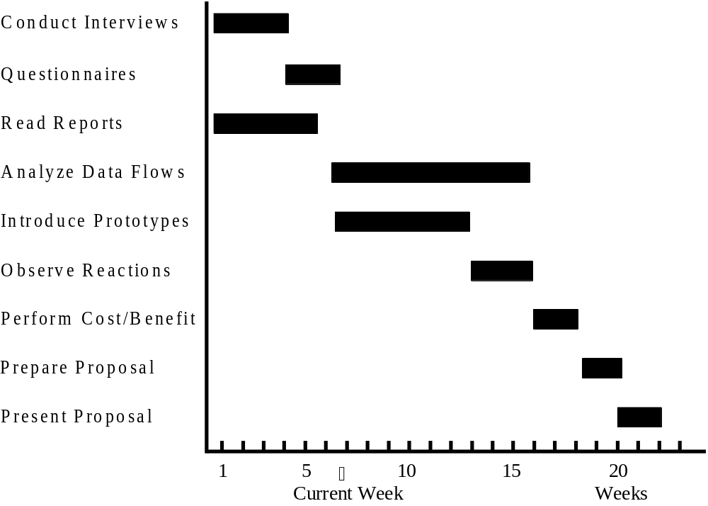
Gantt Chart Example
Kendall & Kendall
Copyright © 2002 by Prentice Hall, Inc.
3-<number>

Slide 16
PERT Diagram
PERT - Program Evaluation and Review Technique
  PERT diagrams show precedence, activities that must be completed before the next activities may be started
  Used to calculate the critical path, the longest path through the activities
  This is the shortest time to complete the project
Kendall & Kendall
Copyright © 2002 by Prentice Hall, Inc.
3-<number>

Slide 17
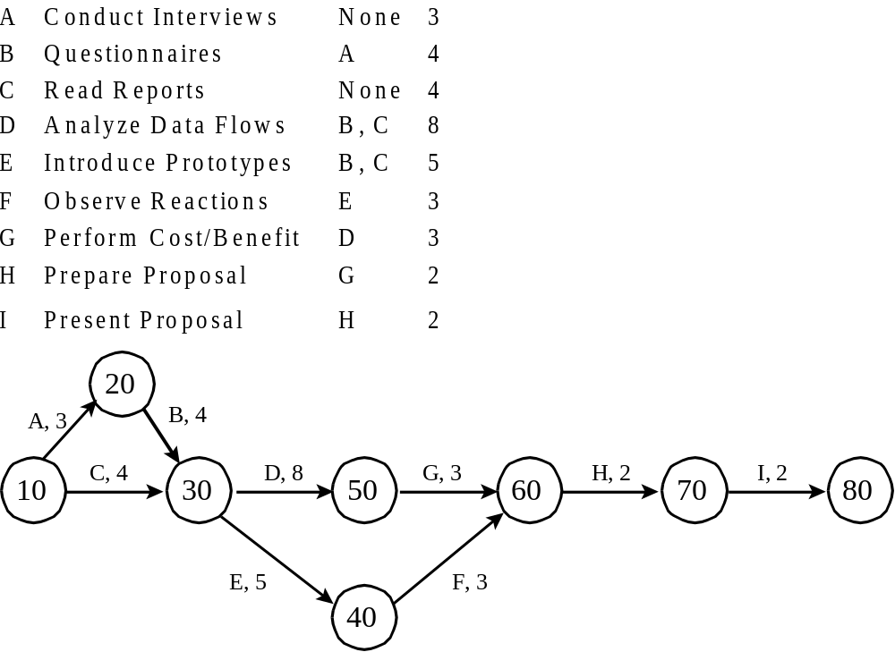
PERT Diagram Example
Kendall & Kendall
Copyright © 2002 by Prentice Hall, Inc.
3-<number>

Slide 18
PERT Diagram Advantages
Easy identification of the order of precedence
Easy identification of the critical path and thus critical activities
Easy determination of slack time, the leeway to fall behind on noncritical paths
Kendall & Kendall
Copyright © 2002 by Prentice Hall, Inc.
3-<number>

